Slide 1




Azure Active Directory Coolness
An overview of some of the lesser used features
Matthew Levy
Enterprise Mobility MVP
https://mattchatt.co.za
@skrods

Slide 2
Identity Governance
Notes:
It provides you with capabilities to ensure that the right people have the right access to the right resources.

Slide 3
Capabilities
Govern the identity lifecycle
Govern access lifecycle
Secure privileged access for administration
Auditable
Notes:
Identity Governance give organizations the ability to do the following tasks across employees, business partners and vendors, and across services and applications both on-premises and in clouds:
Govern the identity lifecycle
Govern access lifecycle
Secure privileged access for administration
Auditable

Slide 4
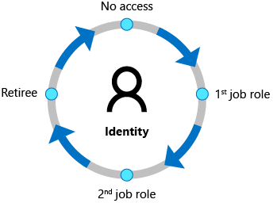
Identity Lifecycle
Notes:
Identity lifecycle management is the foundation for Identity Governance
AAD Premium integrates with Workday and SuccessFactors (Human Capital Management (HCM) systems)
MIM can import from on-prem HCM systems such as SAP, Oracle etc.

Slide 5
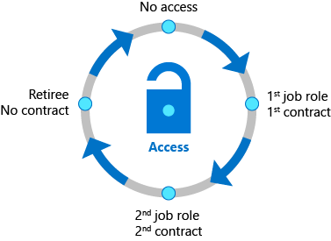
Access lifecycle
Notes:
Typically, IT delegates access approval decisions to business decision makers. Furthermore, IT can involve the users themselves.
Organizations automateaccess lifecycle process through technologies such as dynamic groups and System for Cross-Domain Identity Management (SCIM) (REST API endpoints)
Then access can be reviewed regularly using AAD Access reviews.
Entitlement management enables you to define how users REQUEST access across packages of GROUP and TEAM membership, application roles and SharePoint roles.
Conditional Access policies – Such as Terms of Use (POPIA)

Slide 6
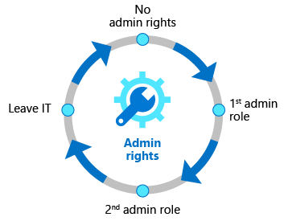
Privileged access lifecycle
Notes:
Azure AD Privileged Identity Management (PIM) provides additional controls tailored to securing admin access rights.
Just-in-time access, alerting capabilities. CA and MFA
As with other forms of access, organizations can use access reviews to configure recurring access recertification for all users in administrator roles.

Slide 7
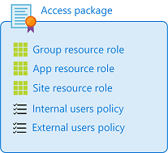
Entitlement management
Catalog
Resources (Groups, Teams, Sites)
Access Package
Resources (from catalog)
Roles
Who (Internal users, external users, assigned users)
Approval
Lifecycle (Expiration, access reviews)

Slide 8
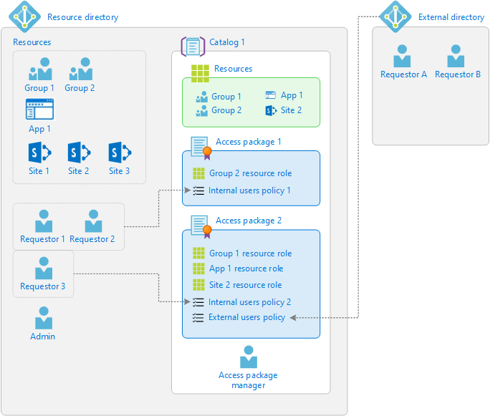

Slide 9
DEMO
Secure and Managed Business to Business Collaboration with Azure AD B2B Extranets

Slide 10
Useful Resources
Create a B2B extranet with managed guests | Microsoft Docs
Identity Governance - Azure Active Directory | Microsoft Docs
Collaborating with people outside your organization | Microsoft Docs

Slide 11
Questions

